Slide 1
Air Traffic Management System Advisors
P. O. Box 6175
Birchleigh
1621
South Africa
e-mail; atms.advisors@gmail.com
Tel; + 27 (0) 11 9651864
Mobile; Arthur Bradshaw; + 27 (0) 828916269

Slide 2

2nd Annual Weather SMART Science Symposium
18/03/2019
Criticality of accurate WX information on the ATM System

Slide 3
OUTCOMES / USER EXPECTATIONS
The ATM System seeks to engage the ATM Community as appropriate with the aim of achieving best business and safety outcomes.
System delivered trajectory
User requested trajectory
TOTAL SYSTEM PERFORMANCE and SAFETY

Slide 4
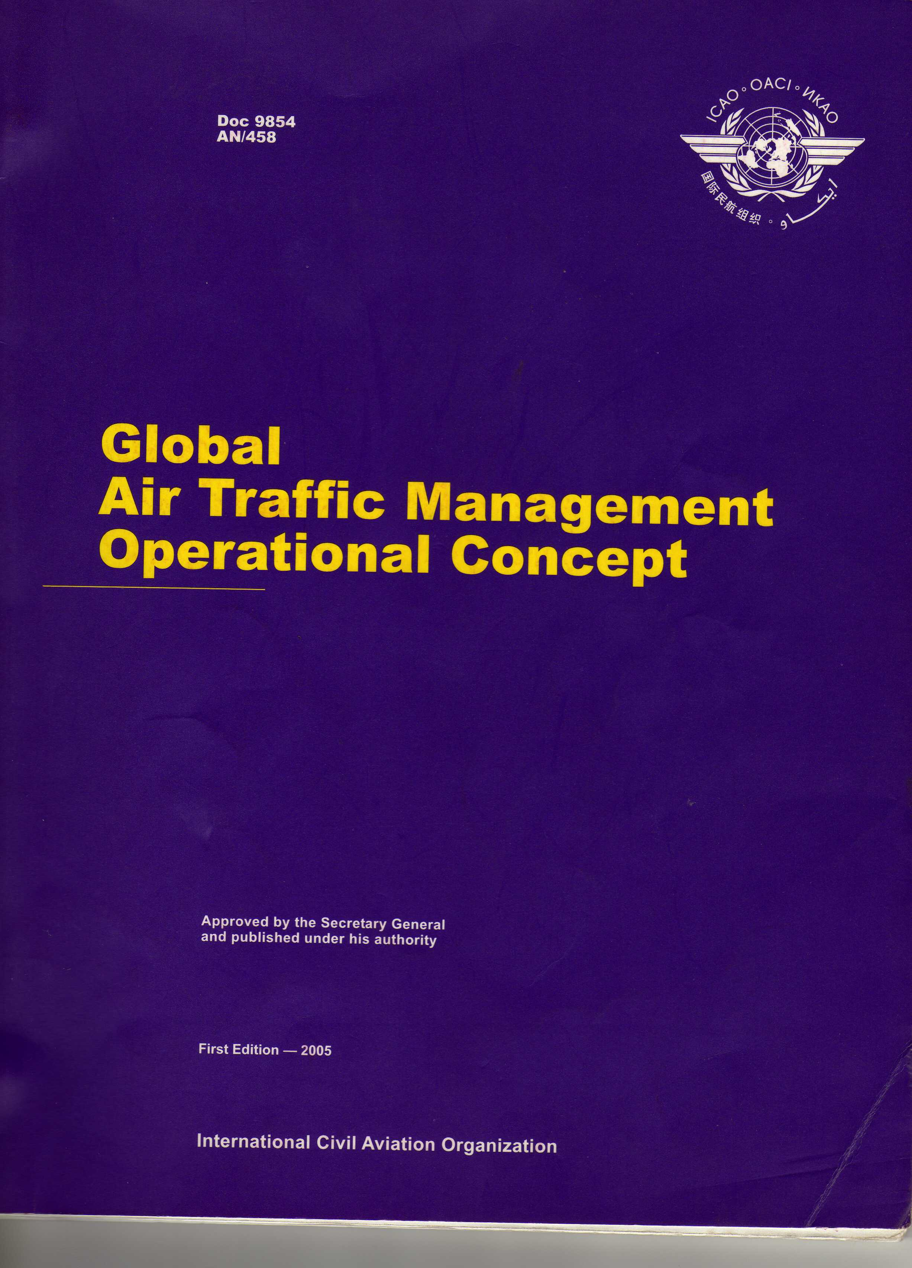

DOC 9854 AN 458

Slide 5
ATMOC Components
Elements
Airspace Organization and Management
AOM
Conflict Management
CM
Traffic Sequencing
TS
Demand / Capacity Balancing
DCB

Slide 6
ATMOC Components
Actors/Activities
Aerodrome Operations
ADOPS
Airspace user Operations
AIROPS
ATM Service Delivery Management
ATMSD

Slide 7
ATMOC Prerequisites
Medium/Glue
Information Management/Services
IM/S
Collaborative Decision Making
CDM

Slide 8
ATM OPERATIONAL CONCEPT
ATMOC Components
Actor /
Activities
OUTCOMES
(USER EXPECTATIONS)
Medium /
Glue
Elements
Integrated Services and SAFETY

Slide 9
SYSTEM WIDE INFORMATION
PREDICTABILITY
DEMAND AND CAPACITY BALANCING
TRAJECTORY MANAGEMENT
RANDOM ROUTES-FLEX TRACKS –FREE FLIGHT
COLLABORATION
PERFORMANCE MANAGEMENT
SYNCHRONISATION
EFFICIENCY AND SAFETY
STRATEGIC – PRETACTICAL – TACTICAL

Slide 11
NO MORE SILOS
NO MORE GUESSING AS ACCURACY IS A REQUIREMENT FOR EFFICIENCY AND SAFETY
AS UNPREDICTABLE AS THE WX BECOMES, THE MORE PREDICTABILITY REQUIRED
THE ATM COMMUNITY DEPENDS ON YOU!!!!

Slide 13
